Slide 1

CENTRO DE INVESTIGACIONES DEL MAR Y LA ATMÓSFERA :
Main research activities
Carolina Vera
Director

Slide 2

CIMA is a joint Research Institute between the National Council of Scientific and Technical Research (CONICET) and the University of Buenos Aires (UBA).
CIMA is one of the CONICET-UBA Institutes located in the School of Exact and Natural Sciences (FCEN).
CIMA has a strong interaction with the Department of Atmospheric and Ocean Sciences of UBA/FCEN. Most of CIMA researchers are Professors or Professor Assistant at the Department.

Slide 3
STAFF:
The staff at CIMA is comprised of CONICET Researchers, UBA Professors and Professor Assistants, CONICET Technical/Administrative employees, graduate and undergraduate students under fellowships supported by different institutions, and contracted employees.
Currently CIMA includes 19 Researchers, 25 postgraduate, graduate and undergraduate students, and 8 technical/administrative employees.

Slide 4
Mission Statement:
To expand the knowledge of the physical processes controlling and determining the behavior of both atmosphere and ocean, in the context of the earth system.
To contribute to the formation of future researchers and technicians.
To promote the transference of both knowledge and technology for society benefit.

Slide 5
CIMA Modeling activities:
Numerical modeling related activities have been the distinctive feature of CIMA since its creation.
Currently CIMA is the research institute in Argentina with the largest amount of researchers with expertise on numerical modeling of both atmosphere and ocean.
CIMA facilitates the computing facilities and technical support needed for modeling activities.

Slide 6
RESEARCH STRATEGY
Applications
REGIONAL FOCUS ON:
SOUTHERN SOUTH AMERICA
&
SOUTH ATLANTIC
Modeling
Analysis and Process Studies
Impact Studies
Mesoscale | Synoptic | Intraseasonal | Interannual & Decadal | Climate Change

Slide 7

Río de la Plata related processes
Research Staff: C. Simionato, D. Moreira, M. L. Clara Tejedor
From SHN (Argentina): W. C. Dragani, M. Fiore, E. D’Onofrio, P. Martin
From INIDEP (Argentina): R. Guerrero, C. Lasta, M. Acha, H. Mianzán, A. Jaureguizar
From IFREMER (France): F. Cayocca, P. Le Hir, F. Gohin, V. Garnier
To understand and to improve our capability of modeling the hydrodynamic and sedimentary processes in the Río de la Plata
To understand the system response to climate variability and change
To understand the relationship between the biological and physical processes in the estuary

Slide 8
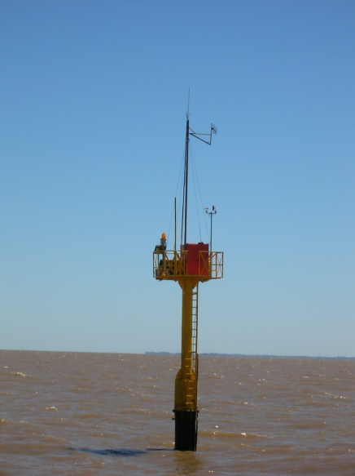
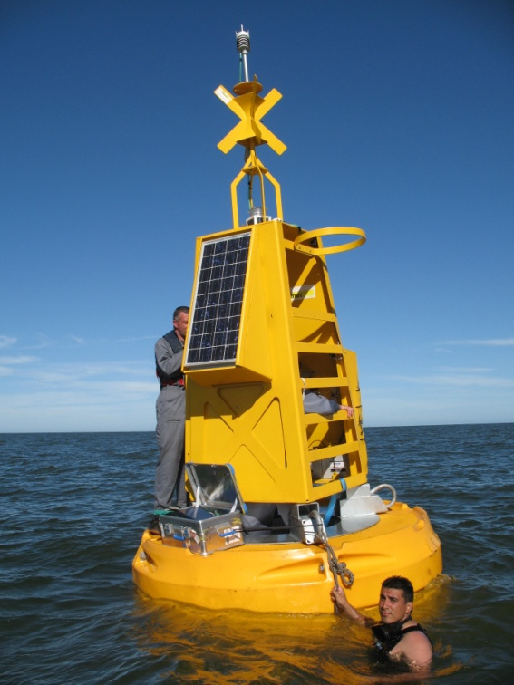
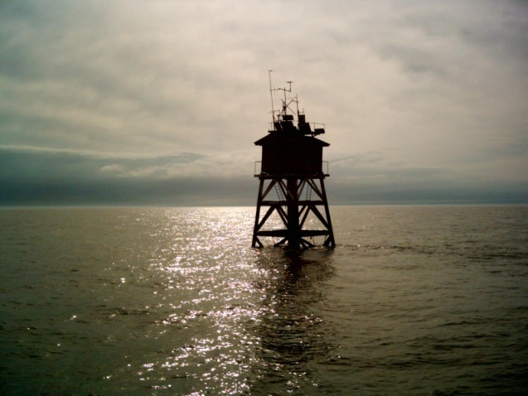
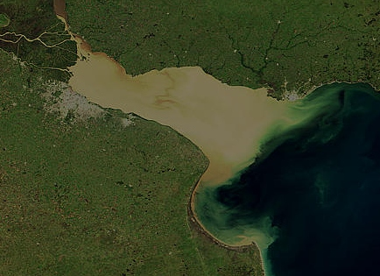
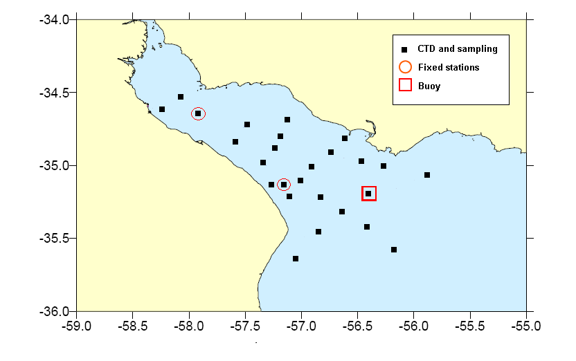
Monitoring the Rio de la Plata
Pilote Norden
Torre Oyarbide
Oceanographic campaigns
Notes:
In this moment in situ and satellite observations are been collected in the Río de la Plata estuary. 2 fixed stations were deployed in the points shown as red dots in the lower figure; they measure pressure (for waves), temperature, salinity, fluoride and turbidity
Data are collected every two to three months

Slide 9
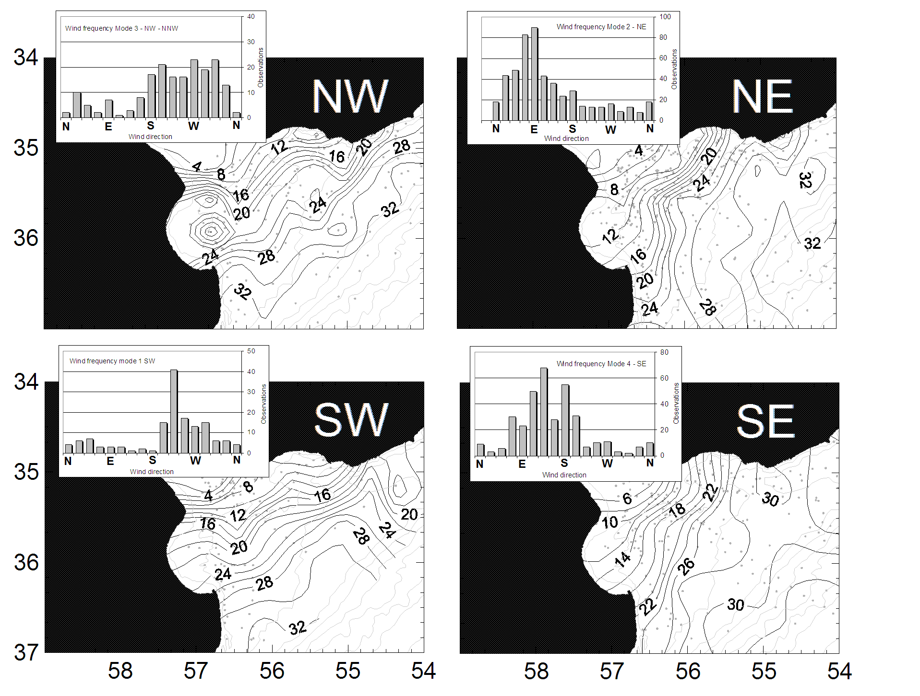
Models and observations are used to understand the impact of diverse forcings on the estuary variability at different time scales
From Meccia, Simionato & Guerrero, submitted to Est Coast Shelf Sci
Notes:
Salinity in the Río de la Plata as a function of wind direction (direct observations): it is found that wind variability in short time scales strongly affects the Río de la Plata salt wedge variability. This, in turn, has an impact on the fishes which use this area for spawning and nursing and on sedimentation. Changes in the wind regime can therefore modify the characteristic patterns in this estuary with significant impacts.

Slide 10
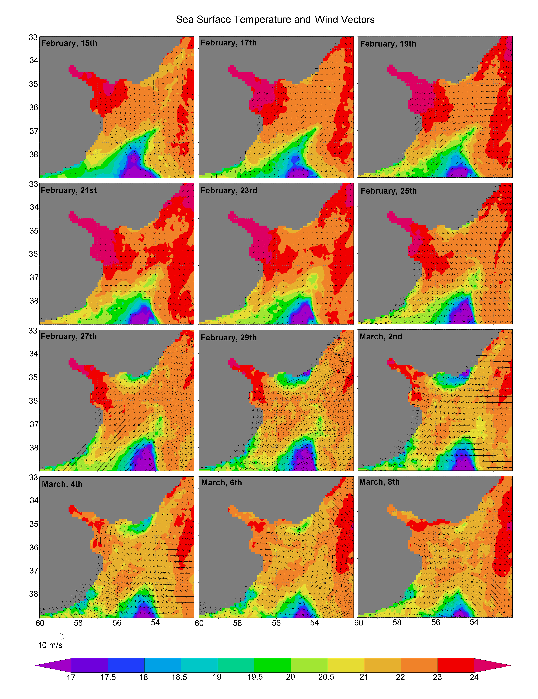
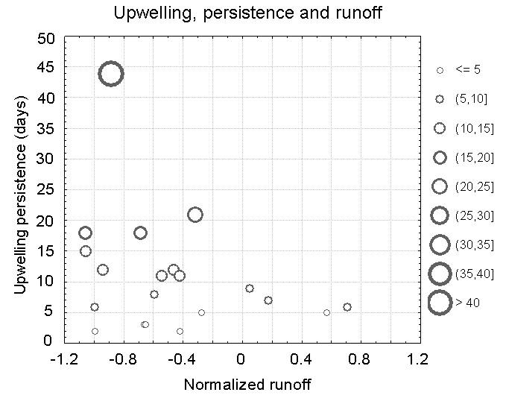
Wind variability and runoff have a large impact on the SST in this shallow area
From Simionato, Luz Clara, Campetella, Guerrero & Moreira. CSR in press
Notes:
Left: Satellite SST and winds observations. Wind variability produces large changes in the SST, as for instance upwelling along the Uruguayan coast. Right: it was found that this process is modulated by climate variability through the runoff and, therefore, climate variability and change have a large impact on this process

Slide 11
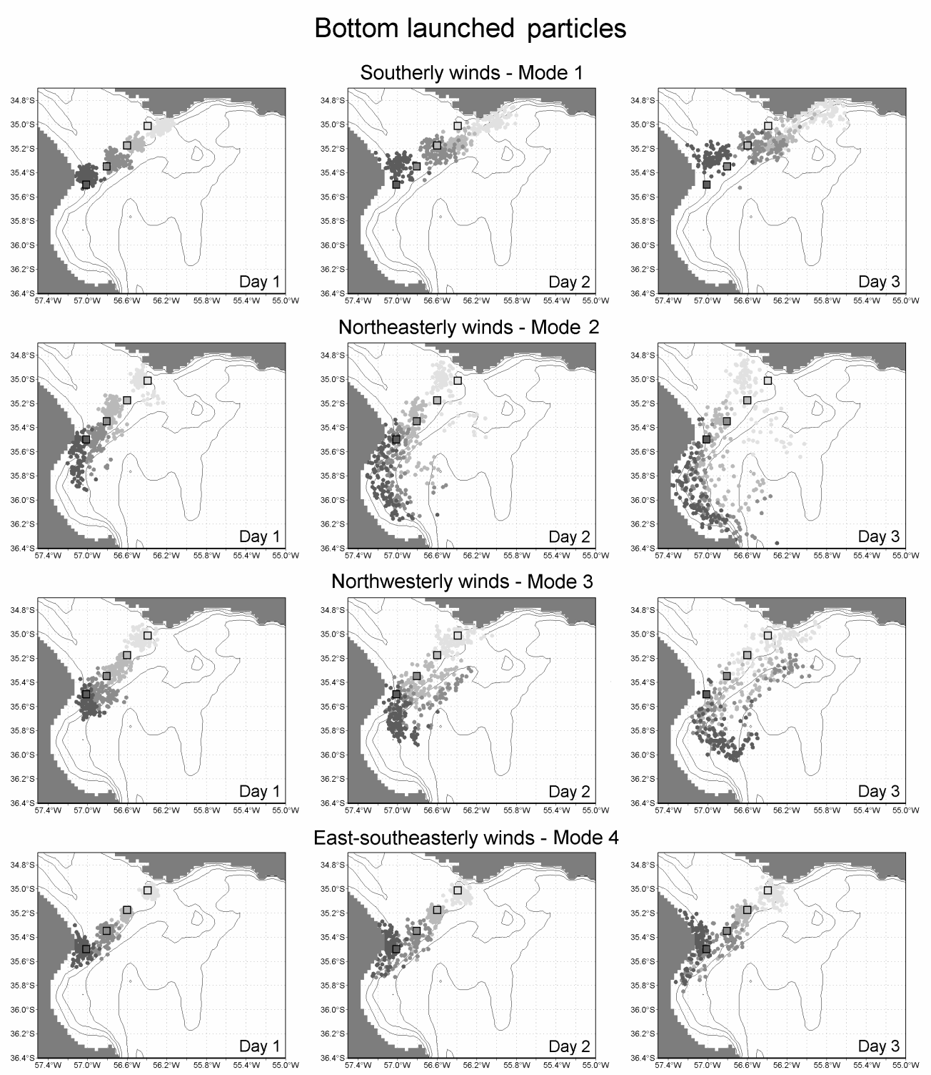
Models are being used to understand the reasons that make this estuary retentive for fishes (and contaminants!) in cooperation with INIDEP
From Simionato, Berasategui, Acha & Mianzan. Est Coast Shelf Sci 2008
Notes:
Dispersion of particles in a numerical model of the Río de la Plata, resembling fish eggs and young larvae. Results indicate that the retention in this estuary results of natural wind variability in short time scales. Changes in winds can therefore affect the retentive properties of the system, used by a number of fishes for spawning and nursing.

Slide 12
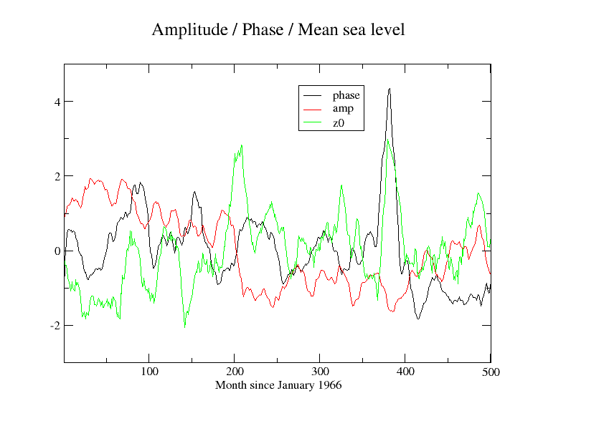
Climate variability is being related to changes in other estuarine processes, as for instance, tidal propagation, in cooperation with SHN
From Luz Clara, Simionato, D’Onofrio & Fiore, manuscript in preparation
Notes:
The figure shows the (normalized) amplitude and phase of the M2 tidal constituent. Even though tides are supposed to be a simple deterministic process, in the Rio de la Plata it displays large inter-annual variability, which seems to be related with variability in the sea level. This last, in turn, changes with the runoff and climate change. Changes on tides have an impact on navigation, sedimentation and the Paraná delta progress.

Slide 13
Deep moist convection in Argentina
PI: Matilde Nicolini. Collaborators: Y. Garcia Skabar SMN- CONICET, P. Salio, M. Torres Brizuela –UBA, H. Ciappesoni SMN- CONICET, M. Suaya, V. Leis, C., SMN, M. A. Silva Dias - University of San Pablo , P. Leite Silva Dias, University of San Pablo, G. Raga UNAM, Mexico
Objectives:
investigate the mechanisms controlling convection and to focus on short range prediction of these mechanisms.
to develop a weather forecast system in the storm scale to characterize convection in the north-central domain of Argentina, from two different strategies: an explicit deterministic prediction of convection with high resolution and an ensemble forecast that allows a probabilistic approach.

Slide 14
Mesoscale circulations east of the Andes
Mountain-plain breeze
Diurnal cycle
a)
Nicolini, M., Skabar, Y.G., Diurnal cycle in convergence patterns in the boundary layer east of the Andes and convection, Atmos. Res. (2010), doi:10.1016/j.atmosres. 2010.09.019.
b)
c)
Notes:
We have demonstrated the existence of a diurnal cycle in the boundary layer divergence and a dependence of this cycle and related convection on the synoptic conditions during a 15-day period during SALLJEX.
During weakly forced environments characterized by anticyclonic circulation,boundary layer regime dominates, characterized by nocturnal eastward anomaly ﬂow and convergence and daytime westward anomaly ﬂow and divergence over the plains. In contrast, during stronger environments (SALLJ conditions), diurnal oscillation in divergence exhibits no reversal of sign in both wind components. Daytime divergence is completely dominated by the zonal component while nocturnal convergence responds to the meridional component effected by the presence of the SALLJ that generates the favorable conditions to trigger organized convection.

Slide 15
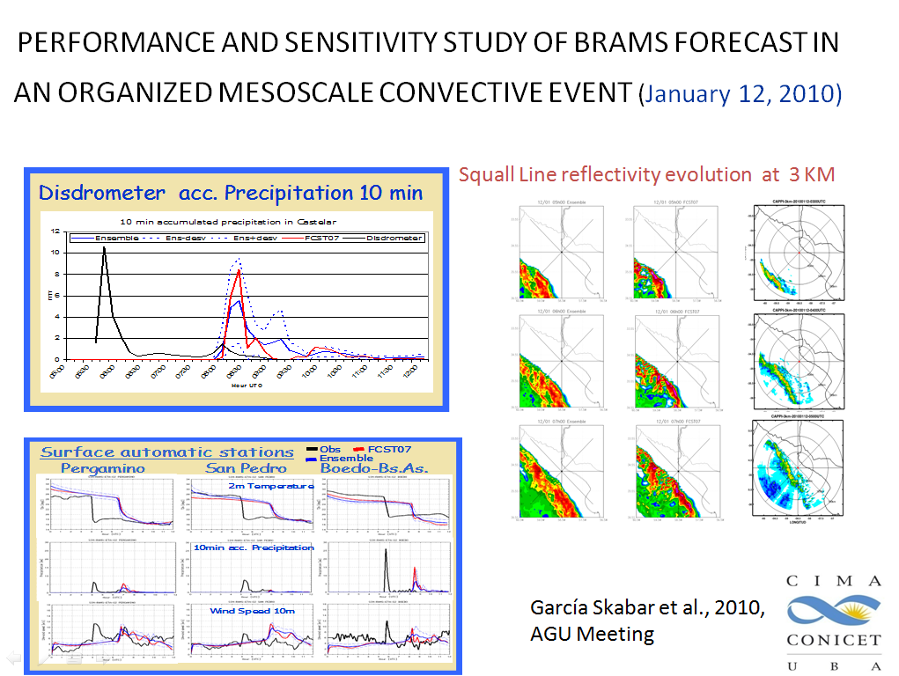

Slide 16
PI: Paola Salio, Collaborators: M. Nicolini, A. Hannart UMI –IFAECI, M. Hobouchian , Y. Garcia Skabar, L. Ferreira, L. Vidal, C. Matsudo, SMN. L. Toledo Machado (CPTEC – INPE), C. Angelis, D. Vila (DSA – INPE) , C. Morales (University of San Pablo), E. Zipser (U Utah), D. Cecil (U Alabama), I Zawadzki (Mc Gill University), F. Tapiador (University of Castilla La Mancha)
Development of techniques to calibrate and check rainfall estimates
Objectives
1. Develop a methodology that will make it possible to have reliable rainfall estimates from different observation sources in the Plata Basin and make these products available to different users.
2. Advance the characterization of deep moist convection over SESA.
3. Study the impact of mesoscale convective systems on rainfall over SESA and their impact on the diurnal cycle of rainfall.
4. Advance the knowledge on the mesoscale mechanisms that trigger and affect the evolution of organized deep moist convection and its impact on rainfall and possible generation of severe phenomena.

Slide 17
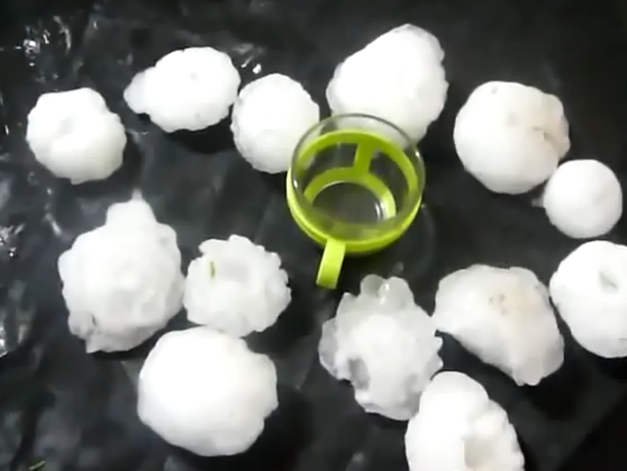
Determination of strong convection and severe weather events considering remote sensing from microwave channels
IR and LIS
85 GHz PCT
Determination of strong MCSs
Determinations of hail trails
Notes:
Considering different source of satellite information clasification and characterization of the intensity of convection is studied over Sout America

Slide 18
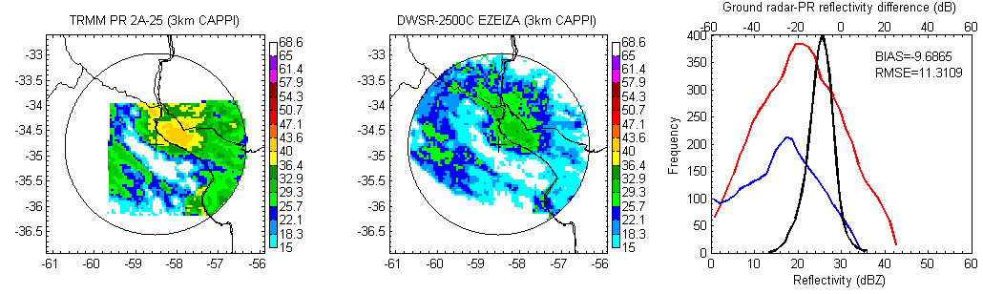
Determination of bias between of Ground Radars considering
TRMM and disdrometers
Ezeiza
Paraná
Notes:
Comparation between TRMM information and GR upper pannels. Red line distribution of observations from TRMM and blue from Ezeiza during a convective case. A Large underestimation is observed in the GR observation. Bias larger than 10 dBz can be obsreved also in the comparation between disdrometer information and GR (lower –left pannel). Parana shows a better performance in all ranges.

Slide 19
Satellite altimetry contributions in the South Western Atlantic Ocean
Improvements of satellite altimetry data over the Patagonian Shelf
PI: M. Saraceno, Collaborators: Enrique D’Onofrio (SHN & DCAO), M. Fiore and W. Grismayer (SHN), Laura Ruiz Etcheverry (CIMA)
Meso and large scale circulation in the SWA Ocean
PI: M: Saraceno, Collaborators: Alberto Piola (SHN & DCAO), Christine Provost (LOCEAN, IPSL), Elbio Palma (UNS), Ted Strub and R Matano (COAS, OSU), Ana Julia Lifschitz (CIMA)

Slide 20
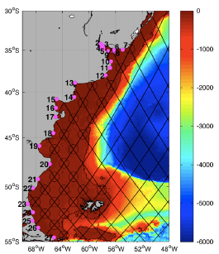
Results
Improvements of satellite altimetry data over the Patagonian Shelf
The main limitation to use satellite altimetry data over the Patagonian shelf is accuracy of tidal models (Saraceno et al, CSR, 2010; Saraceno et al, JGR, 2008)
Work in progress
Further validation of along-track data and implementation of a regional tide model with data assimilation
Fig. 1. Position of the Tide Gauges (magenta dots) and of the crossovers (circles) considered for the comparison between tide models and observed amplitudes and phases. Background: bathymetry (Smith and Sandwell,1997); diagonal lines correspond to the ascending and descending paths of the T/P and J-1 and J-2 missions; the eastern border of the shelf is represented by the 300m isobath( black contour).
Notes:
Fig. 1. Position of the Tide Gauges (magenta dots) and of the crossovers (circles) considered for the comparison between tide models and observed amplitudes and phases. Background: bathymetry (Smith and Sandwell,1997); diagonal lines correspond to the ascending and descending paths of the T/P and J-1 and J-2 missions; the eastern border of the shelf is represented by the 300m isobath( black contour).

Slide 21
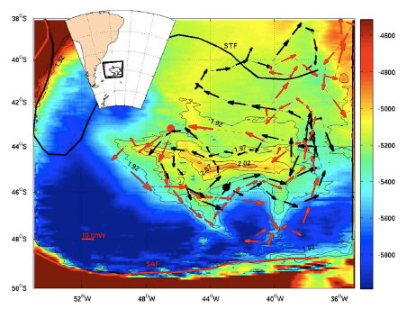
Meso and large scale circulation in the SWA Ocean
Results
Ocean circulation over the Zapiola Rise (45W,45S) shows large interannual variability (Saraceno et al, DSR 2009)
Work in progress
Contribution of mesoscale eddies to the Meridional Overturning Circulation in the Brazil-Malvinas Confluence region
Figure 1: Colors indicate the bathymetry in the Argentinean Basin between 4500m and 6000m depth. Thin black lines indicate f/H isocontours (units –1x10⁻⁸ m⁻¹s⁻¹). The closed contours range from –2.1 x10⁻⁸m⁻¹s⁻¹ to –1.92x10⁻⁸m⁻¹s⁻¹. The mean positions [Saraceno et al., 2004] of the Subtropical Front (STF) and the Subantarctic Front (SAF) are indicated by solid black and solid red lines, respectively. The positions of these two fronts correspond, also respectively, to the southern limit of the South Atlantic Current and to the northern limit of the Antarctic Circumpolar Current. Vector speeds estimated from the trajectories of profilers pf3900111 (red arrows) and pf3900110 (black arrows) are indicated. The profiler starting points are indicated by solid dots. The vector scale (bottom-left corner) is common to both profilers.

Slide 22
Synoptic systems associated with extremes events over southern South America
Norma Possia and Claudia Campetella (PI’s), Alejandro Godoy (PhD student), Carolina Cerrudo (undergraduate student)
Main objectives
to study the dynamical processes associated with extratropical upper level trough,
particularly those who evolve to cut-off lows.
to diagnose the main physical mechanism related to the life cycle of upper level cut-off
lows
characterize the temporal evolution of the 3D structure of coastal cyclones associated
with extreme events (precipitation and/or wind → storm surges, waves, floods)

Slide 23
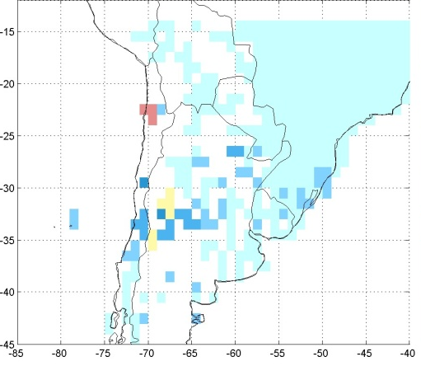
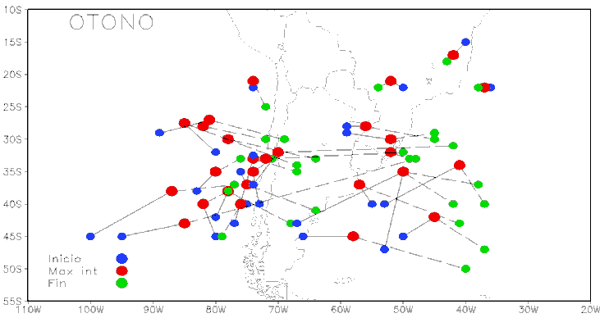

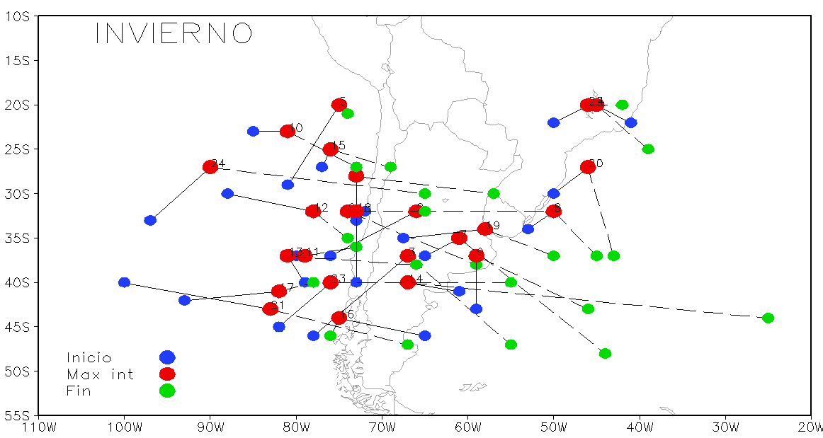
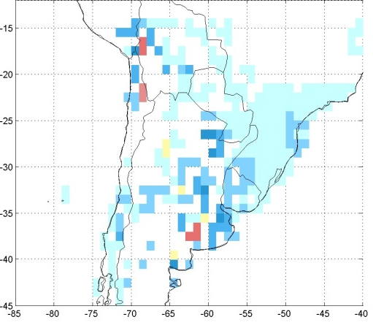
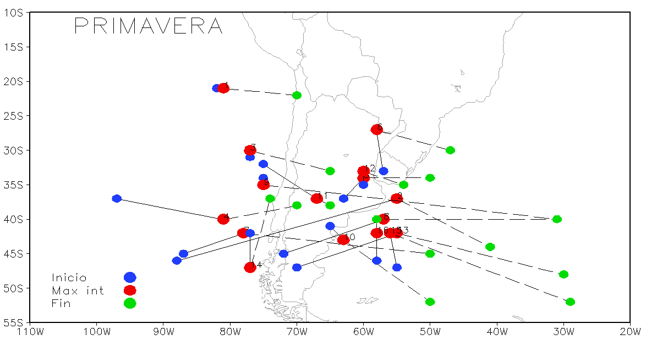
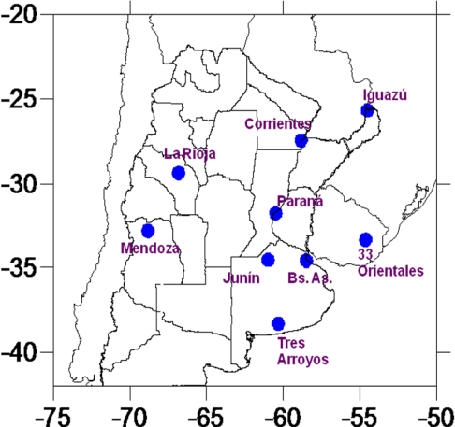
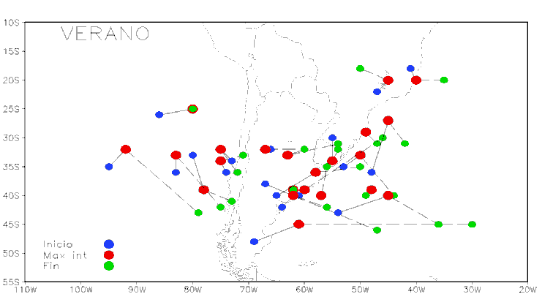
Cut-off Lows – Climatology and impacts
Percentage of seasonal rain associated to COLs
Percentage of COLs associated with a precipitation extreme (above the 75th percentile) for the total COLs affecting each station (including rain and no rain events)
Trajectories of cut off lows affecting southern South America in 2000-2006.
Notes:
Upper level cut off lows affect the continental sector of southern South America with a annual average frequency of 18 events. The main contribution of COLs to the seasonal precipitation occurs in northern Chile (up to 80%) and central-western Argentina during the cold season. In this season about the 30% of the precipitation corresponds to extreme events (above 75th percentile).

Slide 24

Intraseasonal variability in South America
PI: Carolina Vera, co-PI: G. Kiladis, B. Liebmann (NOAA/ESRL)
Collaborators: B. Cerne, M. Alvarez, P. González
More relevant questions
Which are the most relevant mechanisms associated with the leading pattern of precipitation anomalies (seesaw pattern) South America on intraseasonal time scales (10-70 days)?
What is the interaction between the high-frequency perturbations and the MJO in central and eastern South Pacific? How much of the seesaw pattern variability is accounted by such interaction?
What are the links between interannual, intraseasonal and high-frequency variability over central and eastern South Pacific and South America regions?
How well do the current climate models reproduce the dominant mechanisms associated to variability over South America on intraseasonal timescales?

Slide 25
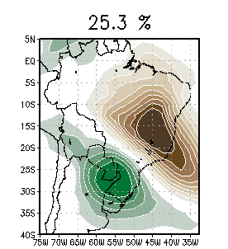
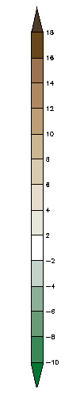
Intraseasonal variability in South America
1st EOF leading pattern of 10-90-day filtered OLR variability
Weakened SACZ
Intensified SALLJ poleward progression
Intensified SACZ
Inhibited SALLJ poleward progression
H
L
+ T. anom
- T. anom
L
H
H
- T. anom
+ T. anom
L
Higher frequency of extreme daily rainfall events at the subtropics
(Liebmann, Kiladis, Saulo, Vera, and Carvalho, 2004)
(Gonzalez, Vera, Liebmann, Kiladis, 2008)
Higher frequency of heat waves and extreme daily temperature events at the subtropics
(Cerne , Vera, and Liebmann, 2007, Cerne and Vera, 2010)
SOUTH AMERICAN SEE-SAW PATTERN

Slide 26

Extremes
Research staff: C. Menéndez, A. Carril, A. Anna Sörensson, R. Ruscica, P. Zaninelli
How does anthropogenic climate change influence the likelihood of occurrence of extreme weather/climate phenomena?
To what degree can we relate the regional changes in variability/extremes to changes in the large scale atmospheric circulation?
Advance understanding of the extreme event occurrence from a physical point of view. (e.g. do soil-atmosphere interactions influence extremes of precipitation and temperature?)

Slide 27

CLARIS 1 multi-model ensemble (1991-2000)
Taylor diagrams for 75th percentile of maximum and 25th percentile of minimum surf. air temperature in southern La Plata Basin
Taylor diagrams for percentile 75 of maximum and percentile 25 of minimum temperature (TX and TN) for DJF and JJA respectively. These diagrams are used to quantify and visualize the overall correspondence between CLARIS FP6 simulations (L: LMDZ, P: PROMES, Rc: RCA3, Re: REMO, E: ensemble mean) and observational climatologies (REF: Tencer et al 2010). Each model performance relative to the reference climatology is visualized by a point on the plot. Each point gives information on three basic statistics: correlation coefficient between modeled and observed data, standard deviation of simulated data, and RMS difference between simulations and the reference data.
Notes:
Taylor diagrams for percentile 75 of maximum and percentile 25 of minimum temperature (TX and TN) for DJF and JJA respectively. These diagrams are used to quantify and visualize the overall correspondence between CLARIS FP6 simulations (L: LMDZ, P: PROMES, Rc: RCA3, Re: REMO, E: ensemble mean) and observational climatologies (REF: Tencer et al 2010). Each model performance relative to the reference climatology is visualized by a point on the plot. Each point gives information on three basic statistics: correlation coefficient between modeled and observed data, standard deviation of simulated data, and RMS difference between simulations and the reference data.

Slide 28
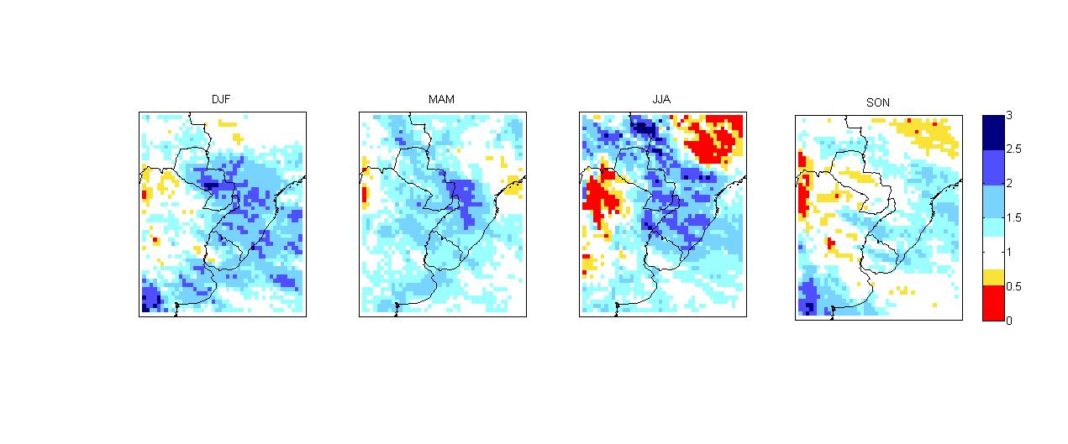

Change in the risk of a daily precipitation extreme event for 2080-2099
(RCA3 driven by ECHAM5-OM)
#
# Areas in blue: the likelihood of occurrence of days with extreme rainfall increases by a factor of 2-3 during 2070-2099
To calculate the risk, we first calculate the percent of wet days for the period 2080-2099, that exceeds the present day 95th percentile. The risk of exceeding the present day extreme rainfall is obtained by dividing this fraction with 5 (since the risk of in present climate is 5 %).
Sorensson et al., 2010, Met.Z.
Notes:
Change in the risk of a daily precipitation extreme event for 2080-2099 simulated by RCA3 driven by ECHAM5-OM. The future likelihood of occurrence of extreme precipitation is defined as the fraction of total wet days exceeding the 95th percentile of the present climate distribution. Areas in blue (values in the range 2-3) indicate that the likelihood of occurrence of days with extreme rainfall increases by a factor of 2-3 during 2070-2099.
Collaboration with Rossby Centre, SMHI, Sweden.

Slide 29
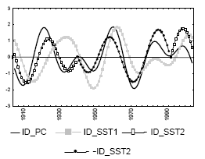
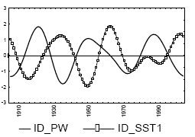
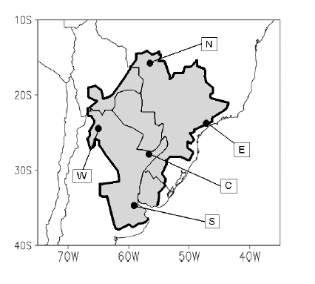
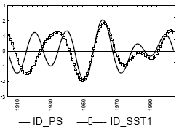
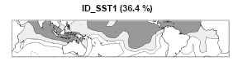
Interdecadal Variability
(20-35 years)
Decadal variations in La Plata Basin and their relationship with large-scale patterns
Research Staff: C. Vera, G. Silvestri, A. Hannart
Standardized anomalies of precipitation anomalies and SST principal components

Slide 30
Soil-atmosphere interactions
Research Staff: C. Menendez, A. Sorensson, R. Ruscica, A. Carril, P. Zaninelli
To contribute to a better understanding of the physical processes associated with soil-atmosphere interaction that govern the regional climate of the La Plata Basin.
Are there particular regions of strong interaction soil moisture-atmosphere in southern South America?
Currently It is being evaluating the degree of soil moisture - atmosphere interaction in the La Plata Basin, using ensembles of simulations performed with a regional climate model (RCA). We identified parts of SESA as a region of potentially strong coupling between soil moisture, evapotranspiration and precipitation through experiments with RCA (e.g. Sörensson & Menéndez, 2010, Tellus A).
The product of evapotranspiration coupling strength and standard deviation of evapotranspiration (ΔΩE*σE).
Notes:
The figure shows the product of evapotranspiration “coupling strength” and standard deviation of evapotranspiration. Evapotranspiration rates are sensitive to soil moisture in dry climates but not in wet climates where it is partially controlled by atmospheric demand. However, a strong coupling with precipitation benefits from high atmospheric moisture variability as found in wet climates but not in dry climates. In consequence, in transition zones between wet and dry conditions (like southern La Plata Basin), where evapotranspiration variations are suitably high but are still sensitive to soil moisture, the land states would tend to have relatively strong impacts on precipitation.

Slide 31
Pi: C. Saulo, Collaborators: M. Seluchi (INPE/CPTEC), P. Spennemann, L. Ferreira (SMN), J. Ruiz, P. González
Dynamics of soil moisture conditions in southern South America
Sensitivity and modeling studies are designed to answer the following:
Which are the pathways for land-atmosphere coupling over our region of concern?
Which mechanisms account for precipitation variability occurring as a consequence of changes in soil conditions: are they mostly related with local moisture recycling and/or with circulation changes?
Which are the most significant oscillations of soil moisture from daily to intraseasonal scales?
Notes:
Más info a partir del resumen del proyecto: Accordingly, the focus is to study the interaction between intraseasonal oscillations and the synoptic scale, both in summer and winter, to explore soil moisture variability, the hydrological cycle and how they affect regional circulation patterns and finally to study how synoptic waves activity and soil conditions modulate intraseasonal variability over South America. Proposed methodologies are diverse and mostly rely on the use of NCEP reanalysis, Global Land Data Assimilation System which are adequate for performing statistical analyses, composite analysis and case studies.

Slide 32
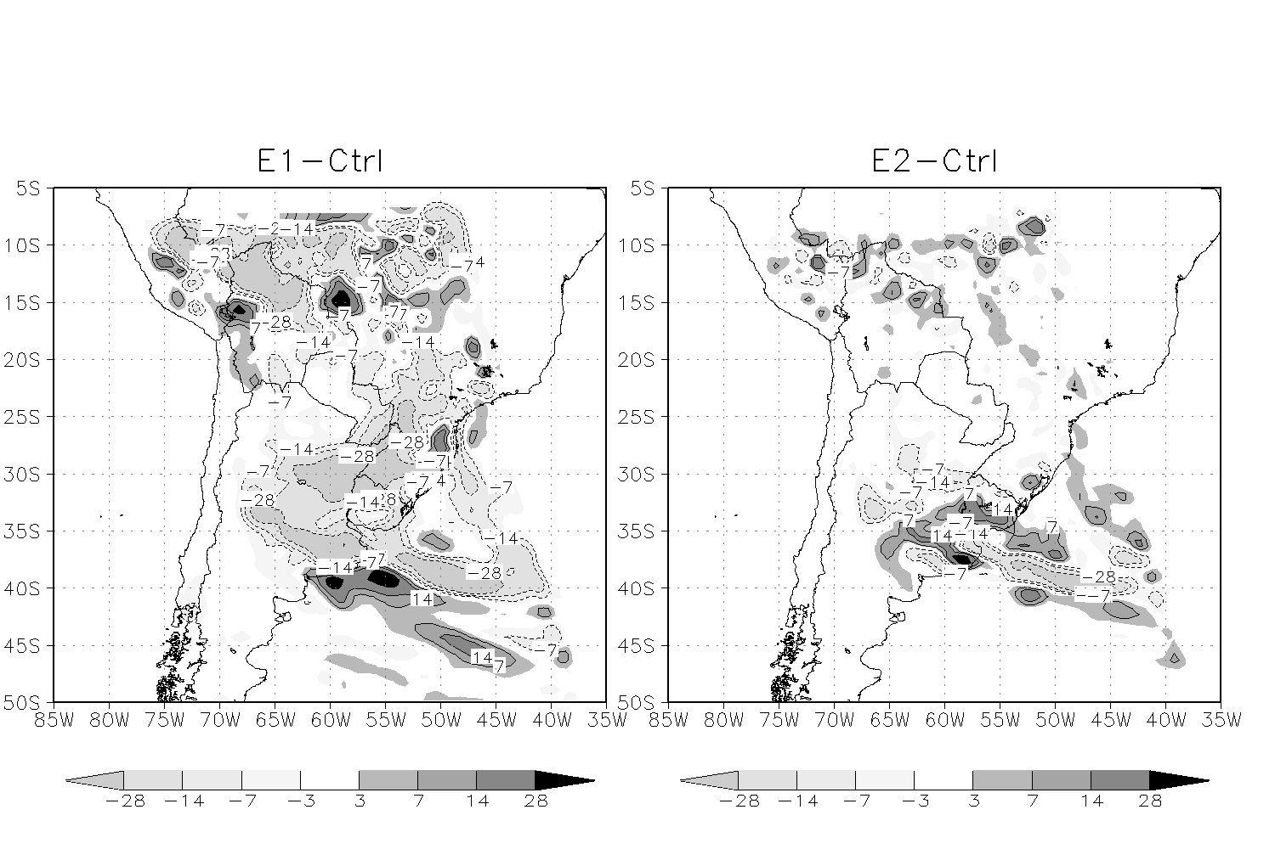
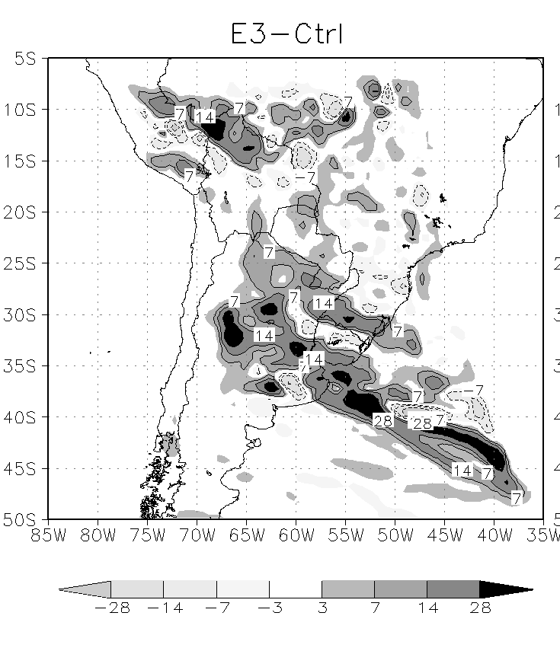
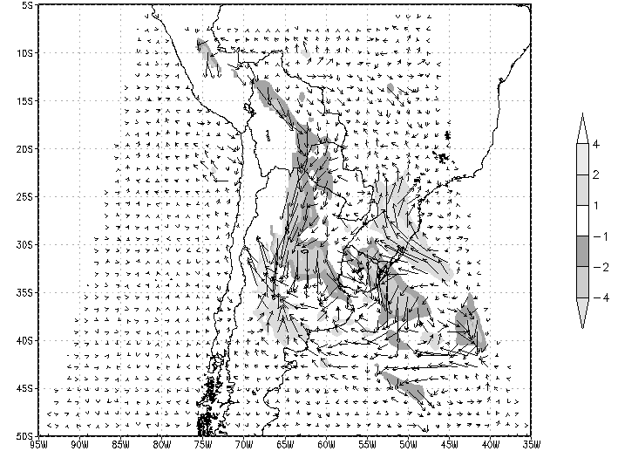
Circulation
Precipitation
SM ↓
SM ↑
SM ↓
Impact of soil moisture (SM) changes. Numerical simulations of a case study for Northwestern Argentina Low event during SALLJEX
Notes:
First and middle panels: : Accumulated precipitation differences (in mm) between each experiment and the control run. E1= soil moisture is increased by 50% over all the domain. E3 = soil moisture is reduced by 50% over all the domain
Last panel: Mean 850 hPa wind anomalies in m s⁻¹ at 0600 UTC for a) E1-CTRL
It was found that land-surface interactions are stronger when soil moisture is decreased, with a coherent reduction of precipitation over southern south America. Enhanced northerly winds result form an increase in the zonal gradient of pressure at low levels. In contrast, when soil moisture is increased, smaller circulation changes are found, though there appears to be a local feedback effect between the land and precipitation The combined effects of changes in the circulation and in local stratification induced by soil wetness modifications, through variations in evaporation and CAPE, are in agreement with what has been found by other studies, resulting in coherent modifications of precipitation when variations of CAPE and moisture flux convergence mutually reinforce.

Slide 33
Soil Moisture Model implementation
PI: M. Doyle
Near Surface (7 cm)
Middle Layer (20 cm)
SImulated Obs
Lower Level (60 cm)
CLASS U3M 1D: Unsaturated moisture movement model is being callibrated in collaboration with the National University of Entre Rios
Test Site: Diamante – Entre Rios Province
Notes:
We are focused on trying to understand how soil moisture interacts with different atmospheric processes and the impact it has on the development of floods in the area of La Plata Basin. Given the scarse information available, since no regular and continuous measurements of soil moisture are performed in the area, soil moisture will be estimated for La Plata basin through a soil moisture model, CLASS U3M-1D. Once the model is calibrated for different locations soil moisture scenarios will be generated and used to study the impact on precipitation in particular situations which lead to flood conditions.
Soil moisture data is measured continuously at some locations in the Province of Entre Rios. Therefore, work is being carried out in collaboration with the National University of Entre Rios, who measure soil moisture at several points in the province using automatic meteorological stations. However, the soil moisture measurements are still in process of being callibrated, therefore these are preliminary results.
The figures present two vertical axis: on the left is the simulated water content and on the right the measured matrix potential which is yet to be converted into water content.
The model seems to be more sensitive to the occurrence of rain than the measured soil moisture, with a rapid response near surface and slowing down with depth.

Slide 34
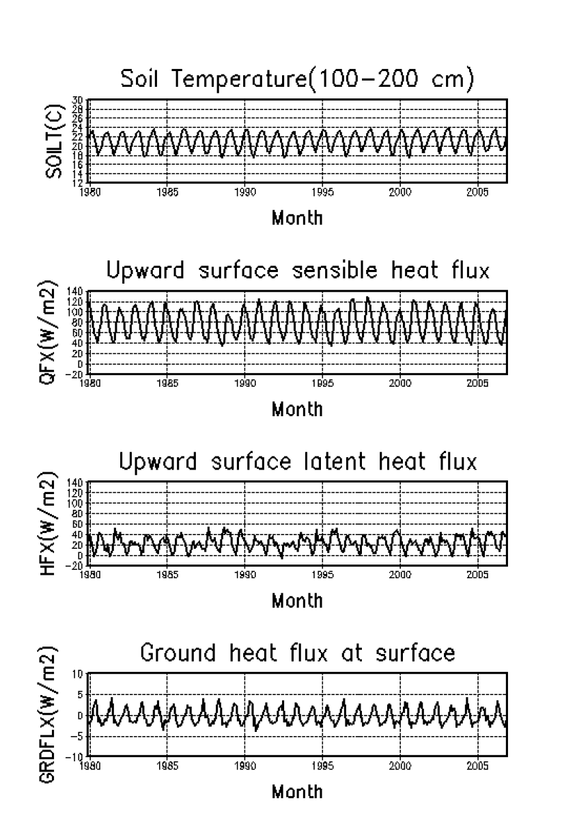
Simulations with NOAH soil model for La Plata Basin
Research Staff: M. Nuñez, A. Rolla

Slide 35
Climate Change projections: errors and reduction of uncertainties
Research Staff: I. Camilloni, V. Barros, M. Doyle, G. Silvestri, P. Antico, R. Saurral, C. Gulizia, N. Montroul, E. Collini (SHN)
To determine the errors of GCMs in simulating the hydrologic cycle and moisture transport and convergence fields in South America
To evaluate if GCMs represent or not heavy rainfall events
To determine how GCMs represent the kinetic energy of disturbances in the atmosphere over middle and subtropical latitudes in South America
According to previous results, to infer what processes are being misrepresented by GCMs
To design corrective strategies of climate projections in the regions where possible

Slide 36
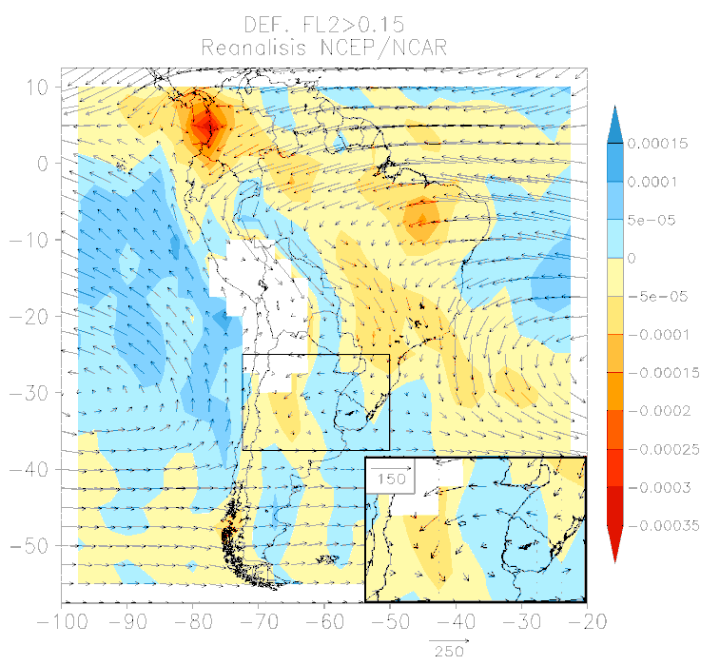
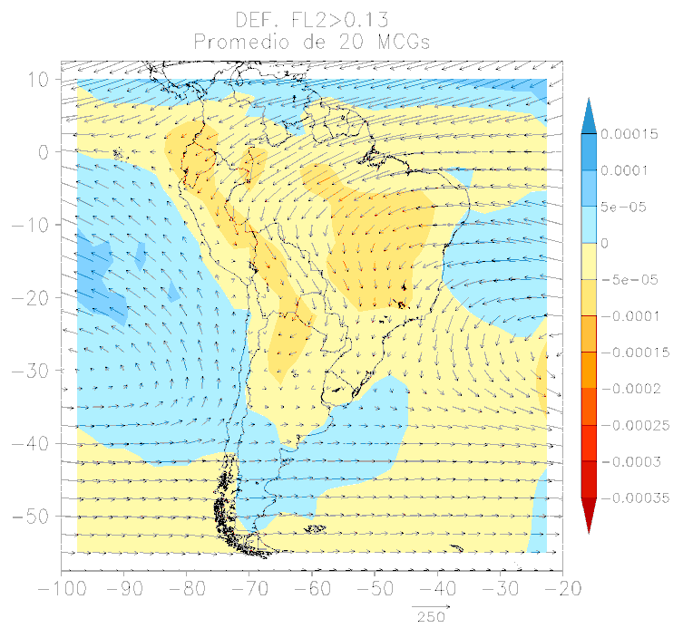
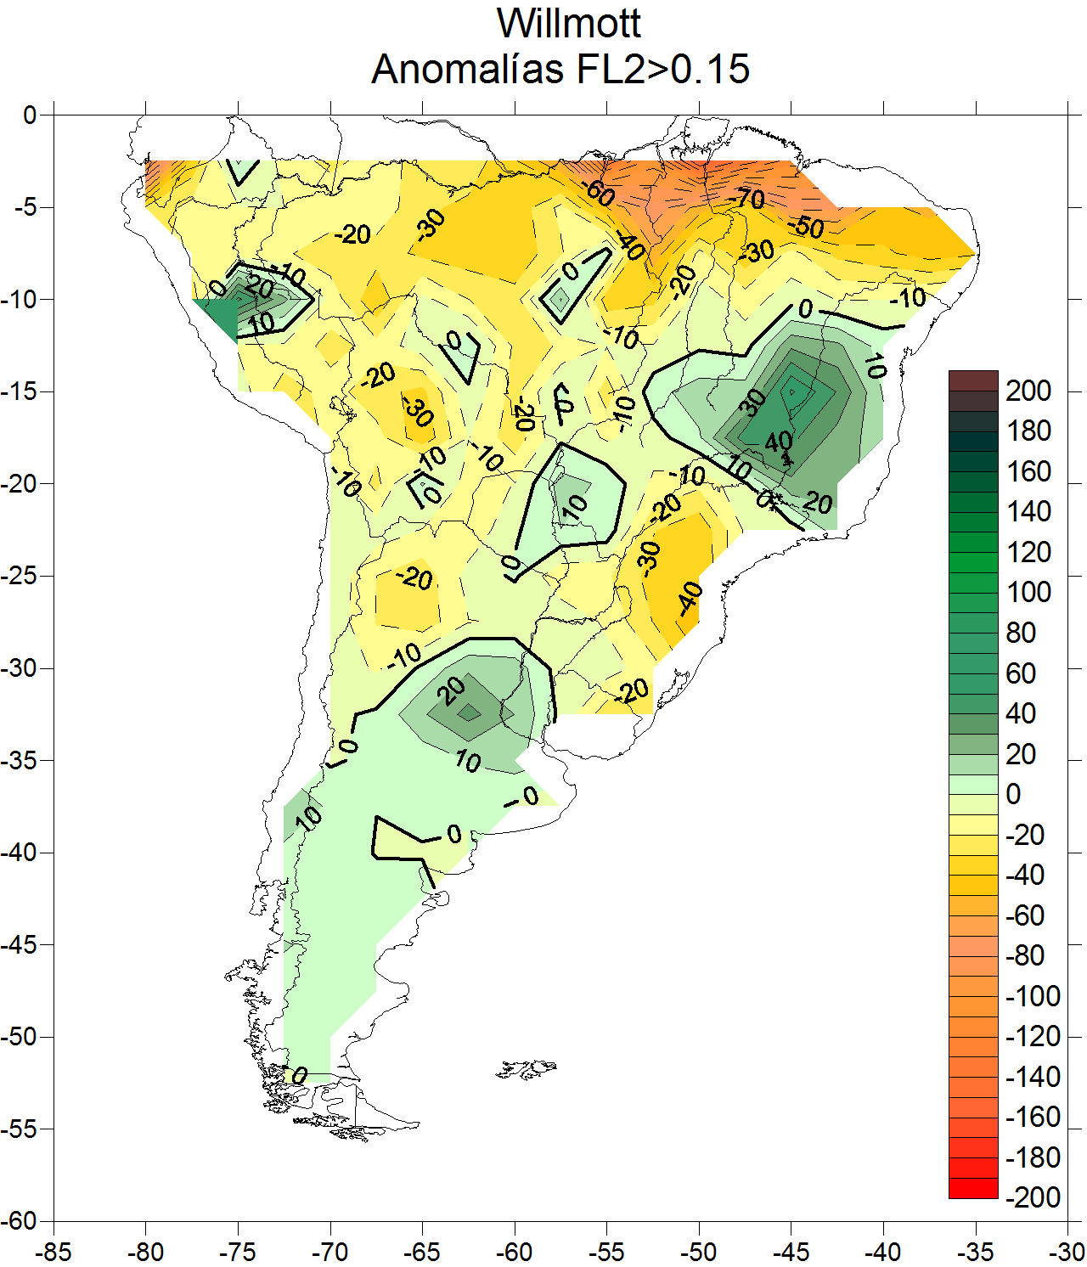
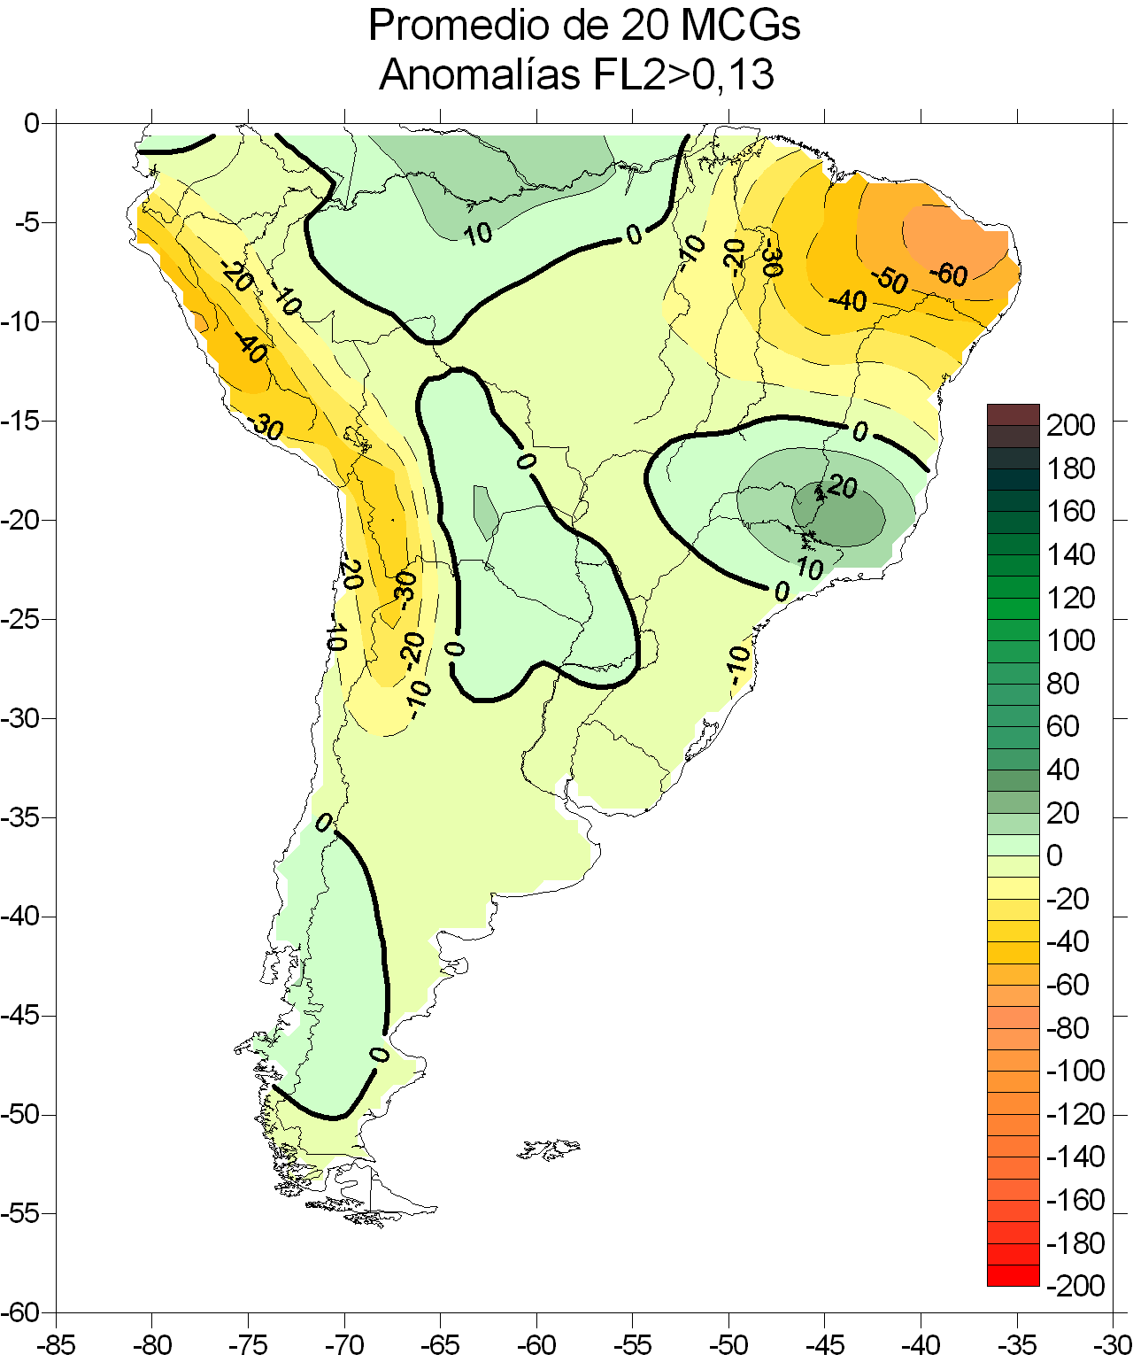
Validation of the representation of the principal patterns of summer moisture transport in South America from the WCRP/CMIP3 dataset
Observed
20 GCMs ensemble
Convergence and moisture transport associated with extremes of PC1
Rainfall anomalies for extremes of PC1
Notes:
The main objective of this study is to identify, for the summer months, the vertically integrated moisture transport patterns derived from NCEP/NCAR Reanalysis in South America for the period 1960-1999, and to evaluate if GCMs, individually and/or the ensemble of 20 of them from the WCRP/CMIP3 Multimodel Dataset, adequately represent some of the modes found. Moreover, we analyzed if the GCMs are able to represent the accumulated precipitation anomaly fields and the convergence and moisture transport associated with the patterns of extremes derived from reanalysis. The results obtained indicate that only some aspects of the convergence and moisture transport and the associated precipitation in South America can be reproduced by the GCMs.

Slide 37
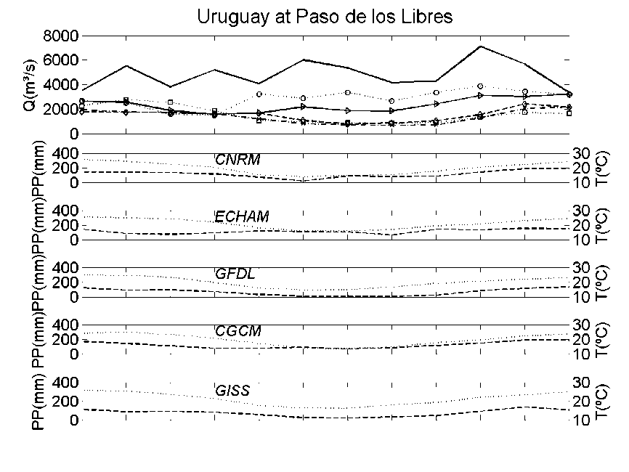
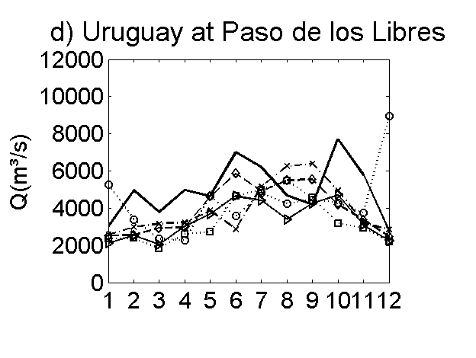
Simulations of the hydrologic cycle of La Plata Basin from WCRP-CMIP3 model outputs
The hydrologic cycle of the La Plata Basin is simulated using the variable infiltration capacity (VIC) distributed hydrology model and forced with atmospheric data from different GCMs to determine to what extent errors in temperature and precipitation fields impact the hydrology of the basin. The skill assessment is performed in terms of simulated runoff at different closing points.
Observed (dark solid line) and VIC simulations of the Uruguay River streamflow annual cycle
VIC simulations results after application of an unbiasing scheme
Notes:
Simulated hydrographs show that all of the GCMs present deficiencies in simulating the regional
climatology of southern South America, and this leads to a very poor representation of the hydrological
cycle of the main rivers across the basin. Two unbiasing schemes are then proposed as a means of correcting
the GCM outputs before forcing the hydrology model, and comparisons between biased and unbiased simulations
are also performed. Results indicate that both schemes, though methodologically different, reduce
the water cycle simulation bias.

Slide 38

Validation of MRI/JMA Model in South America
Research Staff: M. Nuñez, J. Blazquez
MRI/JMA model
ERA 40 reanalysis
Mean 200 hPa wind intensity (shaded) and direction (arrows) for MRI/JMA model (left panel) and ERA40 reanalysis (right panel) for the period (1979-1999), DJF. High Resolution Global Model Performance over Southern South America. Blázquez & Nuñez (2010).

Slide 39
Physical processes related with summer precipitation increase over La Plata Basin in climate change scenarios of GHG concentration increase
Research staff: C. Vera, G.Silvestri, S. Gomez Gomez, C. Junquas (CIMA-IPSL/LMD) , H. Le Treut, L. Li( IPSL/LMD)
Main goal:
Which are the physical processes related with the summer precipitation increase over LPB to GHG concentration increases?
Specific questions:
How do the key elements of the SAMS (such as tropical convection, moisture transport, related atmospheric circulation, etc.) change on climate change scenario? To what extent do they have a role in explaining the precipitation changes in LPB?
How much of the changes projected in LPB are related to the projected changes in the tropical oceanic-atmospheric conditions?

Slide 40
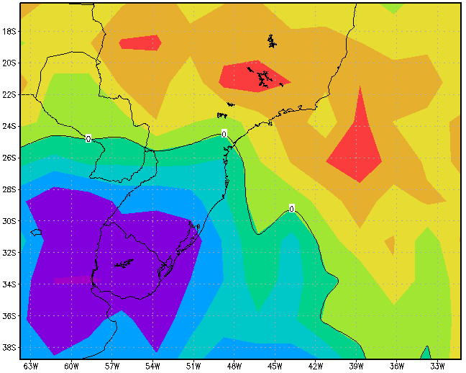

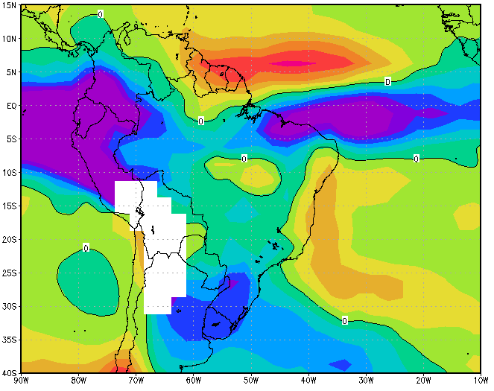
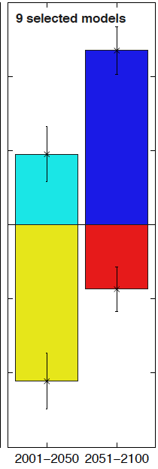
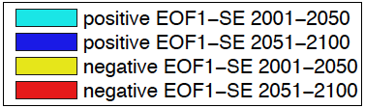
Leading patterns of year-to-year variability of DJF precipitation anomalies (EOF1)
Differences of DJF mean precipitation between (2079-2999) and (1979-1999)
From the ensemble of 18 Models from WCRP/CMIP3 dataset (SRESA1B Scenario)
Changes in the Number of positive and negative EOF1 seasonal events

Slide 41
Regional Climate Modeling over South America
Research Staff: S. Solman and collaborators
Scientific questions
To what extent RCMs are capable of reproducing the main features of regional climate over SA?
  How large are the uncertainties in reproducing regional climate features?
  What are the main limitations in simulating regional climate?
What is the magnitude and spatial pattern of the response of regional climate to regional and remote forcings?
  Regional forcings: Land use changes
  Remote forcings: increase of GHG concentrations.
How reliable/robust are the regional climate responses to regional and remote forcings?

Slide 42
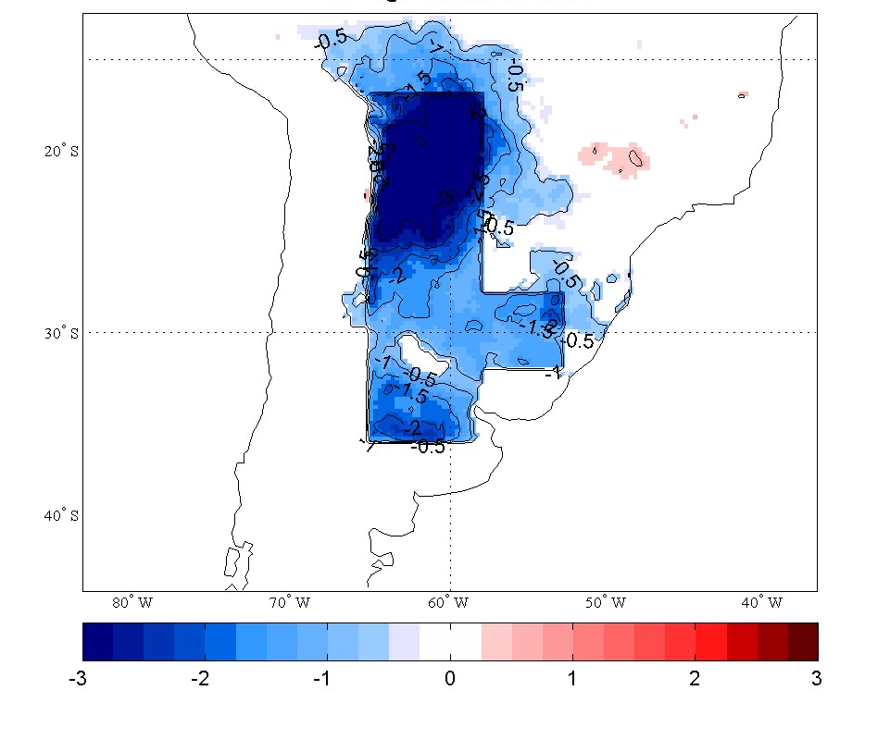
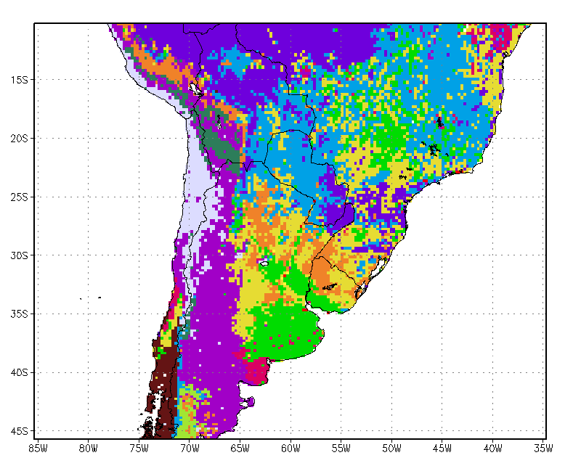
Sensitivity experiments to land cover change were performed with the MM5 model.
Land use changes over South America have been estimated from transformed maps based on satellite observations corresponding to 2008 and 2000 respectively.
Three idealized land use scenarios were defined, where the natural land cover was replaced over the boxes shown in the figure 1 by dry land crop pasture (CROP simulation), by evergreen broadleaf (FOREST simulation), and by bare soil (BARE simulation) respectively.
Fig1: Categories of land use defined in the model. Boxes show the areas that were modified in the sensitivity experiments
Fig2: Differences in temperature at 2m between FOREST and BARE simulations for DJF 1996-1997. Shaded areas indicate significant changes (95% level).

Slide 43
Change in annual mean temperature (left panels), DJF precipitation (middle panels) and JJA precipitation (right panels) for three decades from the HadCM3 ensemble corresponding to SRESA2 scenario. Cabré, Nuñez & Solman

Slide 44
Studies aimed at the optimization of predictive skill at synoptic and regional scales
Research staff: Celeste Saulo, Juan Ruiz, Claudia Campetella
Graduate students: Marcos Saucedo, Pablo Spennemann, Alejandro Godoy,
External collaborators: Eugenia Kalnay, Manuel Pulido, Takemasa Miyoshi, Lorena Ferreira, Martina Suaya, María Skansi
Main activities and areas of research:
Development of probabilistic forecasts for their operational implementation in Argentina
LETKF applied to the estimation of different parameters, in order to reduce the uncertainty related with model parameterizations (i.e, convection)
Implementation of a Data Assimilation System for high resolution NWP regional models
Operational web page with forecast products: http://wrf.cima.fcen.uba.ar
Notes:
En este caso, traté de reunir bajo un gran “paraguas” que es la mejora de la predicción en distintas escalas espacio-temporales.

Slide 45
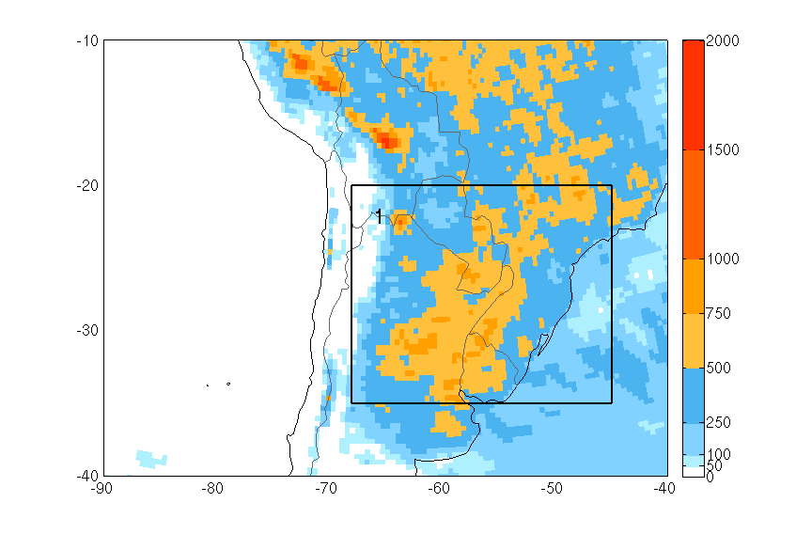
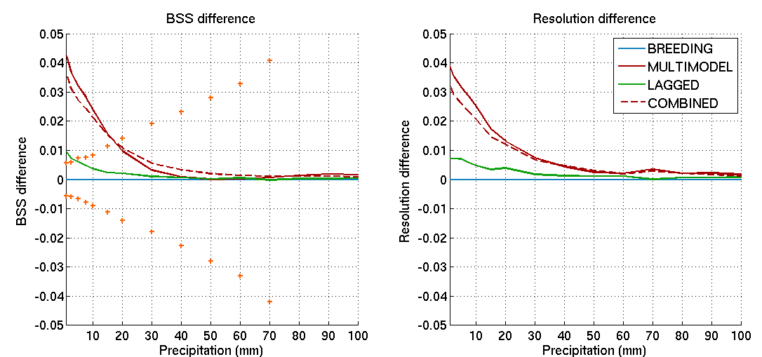
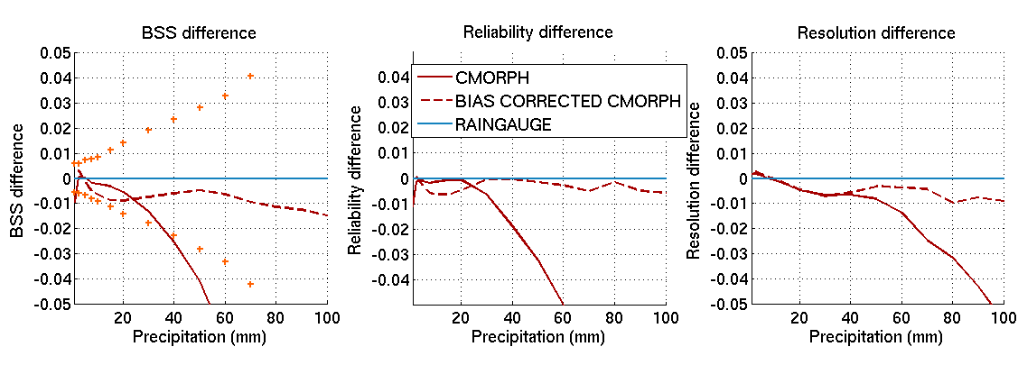
Related results: ensemble generation and calibration applied to probabilistic quantitative precipitation forecasts (PQPF)
48-Hr Forecasts
Notes:
Top panel: the box denotes the area where all the scores have been calculated and 2month accumulated precipitation (december 2002-february 2003). Model domain covers most of South America (is larger than the picture).
Middle panels: Brier Skill Score and its resolution component for different ensemble generation techniques. (Plotted are the differences between the scores obtained with Breeding and those obtained with the rest of the ensemble generation techniques). Crosses correspond to 90% significance level in the BSS panels.
- The difference between PQPF skill mostly associated with resolution component.
-Multi model is the best approach at this lead time (the combined ensemble is slightly worse).
-Initial conditions ensemble seems to be the less effective approach in this case.
-Differences are significant for the lower thresholds.
Lower panels:
Same as before but now showing the difference between the scores obtained after using SALLJEX observational data for calibration (RAINGAUGE), and the scores obtained using CMORPH and bias corrected CMORPH data
CMORPH systematic errors degrade PQPF skill at very low thresholds and at higher thresholds (consistent with CMORPH BIAS over the region).
The BIAS corrected CMORPH is slightly worse than the raingauge network. However this network is not operational over the region. This means that BIAS corrected CMORPH estimates can be used operationally over regions with sparse raingauge coverage.

Slide 46
Parameter estimation using Data Assimilation techniques:
Six hours forecasts
(SPEEDY model)
First guess
ensemble
LETKF
Analysis +
Estimated parameters
Parameter feedback
Observations
Example of analysis error reduction using parameter estimation: Color lines indicate analysis error as a function of time for different parameter estimation experiments. Grey dashed line is the analysis error using an imperfect model (i.e. Without optimal parameters) and black dashed line is the analysis error using the perfect model.
Notes:
Objective: -Reduce model error finding the optimal value for different model parameters.
Model error reduction will improve initial conditions and forecasts.
El esquema de cajas amarillas muestra el ciclo de asimilacion con estimacion de parametros. La idea es que se usa un metodo de asimilacion de datos basado en el pronostico por ensambles (Local Ensemble Transform Kalman Filter LETKF) en donde el ensamble se usa para representar la incertidumbre en el pronostico asociada con la incertidumbre en la condicion inicial y en el valor de los parametros que estan siendo estimados. Los datos se utilizan para corregir el estado de la atmosfera y el valor de los parametros y asi obtener una condicion inicial optima y un conjunto de parametros optimos. El grafico de lineas muestra la evolucion del error del analisis medida segun la "Diferential Total Energy" DTE que es una medida que combina el RMSE de las diferentes variables normalizandolas. El error arranca de valores altos porque el ciclo de asimilacion arranca desde la total ignorancia de las condiciones iniciales y de los parametros optimos. Las lineas de colores (azules y rojas) muestran la evolucion del DTE para el caso en el que se estiman algunos parametros del modelo. SIMULTANEOUS y PARALEL son dos posibles formas de realizar la estimacion (pero esto no es tan importante) y las distintas lineas rojas y azules corresponden a experimentos que se iniciaron con parametros mas cercanos o mas lejanos al valor optimo. La linea gris corresponde al DTE del analisis realizado con el modelo imperfecto y la linea negra corresponde al realizado con el modelo perfecto (es la que tiene menor error como era de esperarse, aunque las lineas de colores se acercan mucho mas a la del modelo perfecto que a la del modelo imperfecto). Es importante notar que esta figura se genero con un experimento gemelo (el modelo era perfecto salvo para los parametros cuya estimacion se estaba investigando y las observaciones eran generadas sinteticamente utilizando el modelo y un ruido al azar que representa el error de las mismas). La idea a corto y mediano plazo es ir haciendo experimentos mas realistas para llegar a utilizar observaciones reales en la estimacion de los parametros.

Slide 47
Post-doc visit to LMD (J. Ruiz under the supervision of O. Talagrand) :
Using extra-tropical low trajectories to evaluate ensemble forecast systems and to asses short to medium range predictability.
Objetives:
Evaluate predictability of system path and characteristics using different models and ensemble systems.
Evaluate the relationship between ensemble spread and forecast error and verify probabilistic forecast for different characteristics of the extra-tropical low systems.
Evaluate predictability associated with the characteristic of the system.
Methodology:
Use a tracking algorithm to compute extra-tropical low trajectories forecasted by different global ensemble systems (TIGGE).
Possible product development:
Forecasted tracking of extra-tropical low systems.
Probabilistic forecast of extra-tropical low pressure systems.
Object oriented operational verification of geopotential heights.

Slide 48
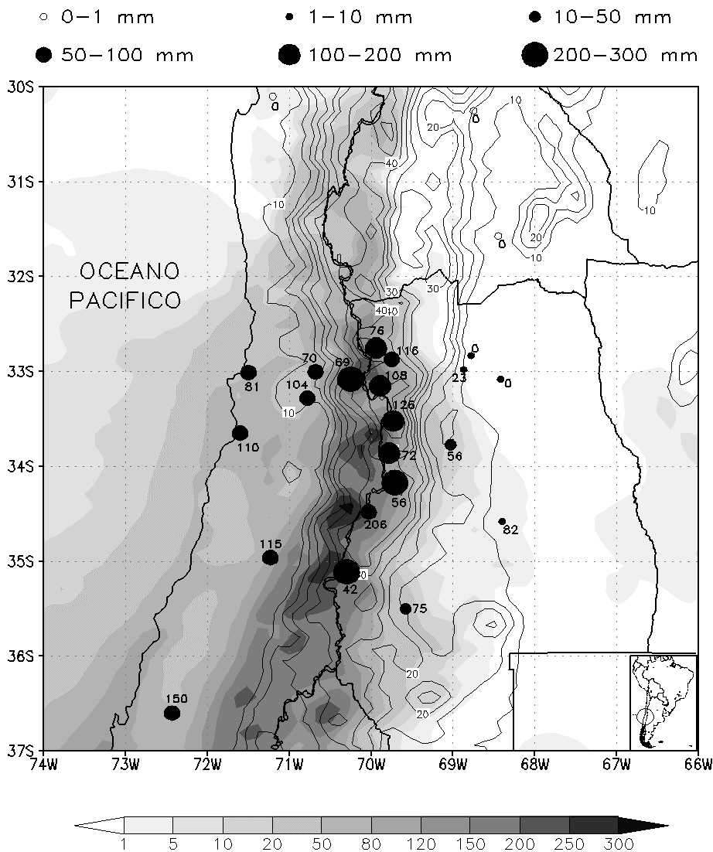
Regional Modeling in the Central Andes region
Precipitation forecasts using ETA model over the Andes Mountains. Viale & Nuñez (2010).
Notes:
Tesis doctoral de Maxi Viale realizada en el CIMA/IANIGLA.
Precipitación total pronosticada a 96-horas por el modelo Eta-PRM desde las 1200UTC de 25 Agosto hasta las 1200UTC del 29 Agosto 2005 (sombreado en mm). Los círculos llenos indican la precipitación observada en cada estación de acuerdo a su tamaño, y los números al lado de dichos círculos indican el porcentaje pronosticado por el modelo de la precipitación observada. La topografía del modelo esta dibujada con líneas de contornos cada 5 hectómetros por encima de los 10 hm.

Slide 49


Development of Seasonal rainfall prediction tools for Argentina
Statistical Prediction methods: M. González, and collaborators
Dynamical-statistical methods based on ensemble of global predictions on seasonal scales: C. Vera, M. Osman
Statistical MJJ Rainfall prediction at
Limay and Neuquen River Basins (COMAHUE) .

Slide 50

Pedro Flombaum¹ & Adam Martiny²
¹CIMA-CONICET/UBA, ²University of California Irvine
Global abundance and distribution of two marine cyanobacteria
Reason: Prochlorococcus and Synechococcus are photosynthetic bacteria that play a major role in marine C cycle
Objective: Generate a model based on light, temperature, and nitrogen to quantify the abundance of PRO and SYN at a global scale
Anne Thompson
Notes:
Pedro Flombaum works in collaboration with Adam Martiny, from the University of California Irvine.
He is interested in how biodiversity and climate interact to affect ecosystem functioning, mostly the carbon cycle.
He studies two marine bacteria able to fix carbon by photosynthesis. These bacteria live in all oceans between 40ºN and 40ºS and are the most abundant photosynthetic organisms on earth, and so they are expected to play an important role on the global carbon cycle.
His objective is to generate a model based on light, temperature, and nitrogen to quantify the abundance of PRO and SYN at a global scale.

Slide 51




Project development
1st STAGE
Acquire and compile field observations in a single dataset
3rd STAGE
Use global information for light, temperature and nitrogen to estimate abundance and distribution
2nd STAGE
Develop a statistical model based on light, temperature, and nitrogen
Notes:
P Flombaum compiled a large dataset with all available PROCHLOROCCUS and SYNECHOCOCCUS field observations. He contacted author all around the globe and downloaded information from several open repositories like IFREMER. Each record in his database is a field sample with bacteria counts (number of cells per milliliter) and environmental variables related with the ecology of PRO and SYN. Mainly temperature, light, and nutrients.
With his analyses, he hopes to obtain a regression model able to quantify the abundance of bacteria. A preliminary result showed a 5 orders of magnitude increase in bacteria abundance between 10 and 15 ºC at the sea surface.
The last step of his project is to use the regression model to generate global maps of the bacteria abundance based on satellite Sea Surface Temperature and Photosynthetic Active Radiation.

Slide 52
www.cima.fcen.uba.ar
Contacts at CIMA
Barros, Vicente Ricardo | barros@cima.fcen.uba.ar
Camilloni, Ines Angela | ines@cima.fcen.uba.ar
Campetella, Claudia | claudiac@cima.fcen.uba.ar
Carril, Andrea Fabiana | carril@cima.fcen.uba.ar
Cerne, Bibiana | cerne@cima.fcen.uba.ar
Doyle, Moira Evelina | doyle@cima.fcen.uba.ar
Flombaum, Pedro | pflombaum@cima.fcen.uba.ar
Menendez, Claudio | menendez@cima.fcen.uba.ar
Nicolini, Matilde | nicolini@cima.fcen.uba.ar
Nuñez, Mario Nestor | mnunez@cima.fcen.uba.ar
Possia, Norma | possia@cima.fcen.uba.ar
Ruiz, Juan Jose | jruiz@cima.fcen.uba.ar
Salio, Paola Veronica | salio@cima.fcen.uba.ar
Saraceno, Martin | saraceno@cima.fcen.uba.ar
Saulo, Andrea Celeste | saulo@cima.fcen.uba.ar
Silvestri, Gabriel Emilio | gabriels@cima.fcen.uba.ar
Simionato, Claudia Gloria | claudias@cima.fcen.uba.ar
Solman, Silvina Alicia | solman@cima.fcen.uba.ar
Vera, Carolina Susana | carolina@cima.fcen.uba.ar

